Slide 1

CHD POLICE CYBERTHON 2023
CHANDIGARH POLICE (IN PARTNERSHIP WITH INFOSYS, CHANDIGARH)
CommuniSense by Team Cyber Cipher

Slide 2

CONTENTS
Team Details
Problem Statement – Description / theme selected
Solution Proposed
Expected Benefits to Policing
Technical Design / Architectural Diagram
Solution - Screenshots
Assumptions

Slide 3
PROBLEM STATEMENT
The main problem statement for building an AI-driven sentiment analysis tool for community policing is to create a system that can effectively monitor and analyze public sentiment regarding law enforcement from various sources, such as social media and local news. The system's primary goal is to help law enforcement agencies identify community concerns and public sentiment trends, allowing them to make data-driven decisions, enhance community relations, and improve their policing strategies.
Some critical challenges to be addressed in this problem statement are:
Context Understanding
Real-time Monitoring
Public Perception and Trust
Data Privacy and Ethics
Interpretation and Actionability
Bias and Fairness

Slide 4
SOLUTION PROPOSED
Solution components
Data Collection & Preprocessing: Gathering of data from diverse sources such as Twitter, YouTube, Reddit, etc.
Sentiment/Emotion Analysis & Classification Model: Model is trained on labeled public dataset with sentiment labels (e.g., Positive, Negative, Neutral) and emotion labels (eg. Anger, Fear, Sadness, Disgust, Surprise, Anticipation, Trust, and Joy).
Real-time Monitoring: Component that continuously monitors and analyses social media and local news feeds.
Trend Analysis: Identification and visualization of patterns and trends in public sentiment.
Community Concern Detection: Automatically detect and flag community concerns or issues expressed.
Alerts and Notifications System: Notify law enforcement personnel when there's a significant change in sentiment or the emergence of a critical community concern.
User Interface and Dashboard: A user-friendly interface and dashboard for law enforcement personnel.
Feedback Loop: A feedback mechanism for law enforcement agencies provide input and suggestions.

Slide 5
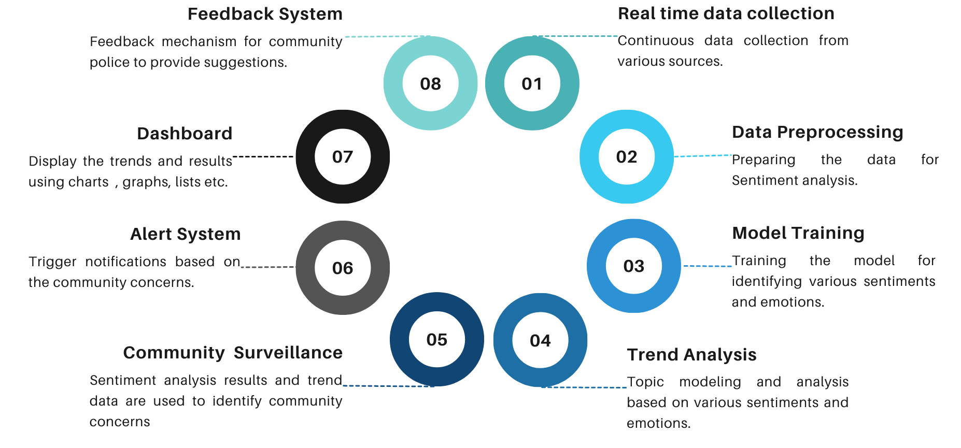
SOLUTION PROPOSED
Data flow and Integration

Slide 6
EXPECTED BENEFITS TO POLICING
Comprehensive Insight: Gain a comprehensive understanding of public sentiment, enhancing decision-making.
Emotion-Based Analysis: Categorize sentiment into specific emotions for tailored responses.
Real-time Response: Respond promptly to evolving community sentiment, fostering trust and cooperation.
Empathetic Engagement: Understand and address emotional nuances in public sentiment, improving relationships.
Data-Driven Decision Support: Use trend analysis for resource allocation and strategy development.
Automatic Concern Detection: Swiftly identify and address community concerns, showcasing responsiveness.
Continuous Improvement: Enhance system performance based on law enforcement agency input, ensuring optimal functionality.

Slide 7
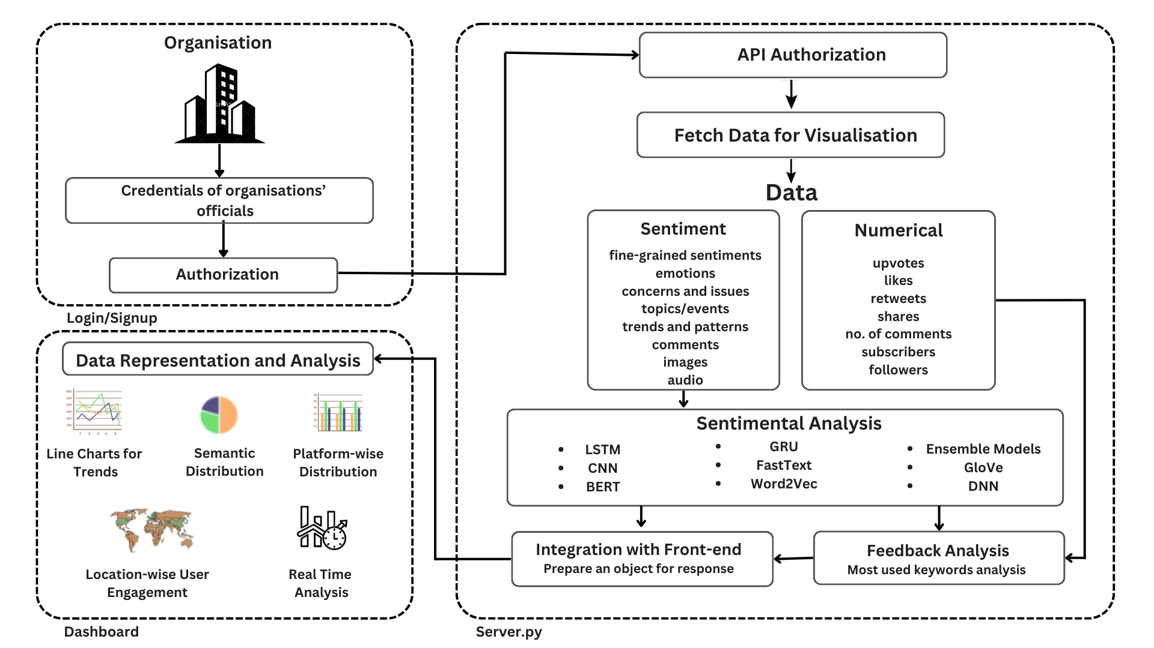
TECHNICAL DESIGN / ARCHITECTURAL DIAGRAM

Slide 8
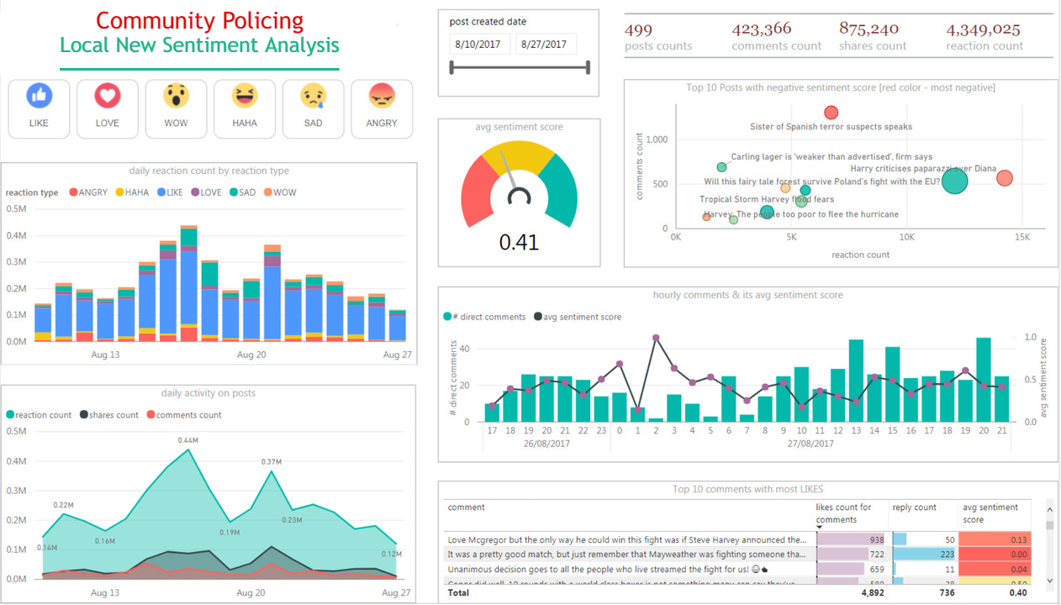
SOLUTION - SCREENSHOTS

Slide 9
CONSTRAINTS & ASSUMPTIONS
Constraints:
Data Privacy and Legal Compliance.
Data Availability and Quality Restrictions.
Geographical and Language Constraints
Data Volume and Velocity Constraints
Third-party Service Availability
Regulatory Constraints
Cultural and Social Sensitivity Constraints
Data Retention and Archiving Constraints
Assumptions:
Data Sources Accessibility
Continuous Real-time Data Flow
Community Policing Opportunities
User Adoption and Feedback
Ethical Usage
Regulatory Compliance
Positive impact on community policing and public sentiment.

Slide 10















TECH REQUIREMENTS

Slide 11

THANK YOU!
devashishgupta9822@gmail.com

